Slide 1


CAPSTONE PROJECT
Sales Performance Analysis For Zepto Grocery
Presented By
Student Name: Himanshu Kumar
College Name: Indira Gandhi National Open University
Department: MCA
Email ID: srivastavahimanshu36@gmail.com

Slide 2
OUTLINE:
Problem Statement
Proposed System/Solution
System Development Approach
Algorithm & Deployment
Result
Conclusion
Future Scope
References

Slide 3
Problem Statement:
Uneven revenue distribution: Tier 3 outlets show highest sales ($472K) while Tier 1 and Tier 2 differ significantly.
Context: Zepto operates multiple outlet types and sizes across tiers; sales vary widely
by item type, outlet size, and location.
Observed issues (from dashboard):
Uneven revenue distribution: Tier 3 outlets show highest sales ($472K) while Tier 1 and Tier 2 differ significantly.
Category concentration: Top categories (Fruits & Vegetables, Snack Foods) contribute disproportionately to revenue.
Outlet-size effect: Large outlets generate the most revenue ($507.9K) while small and medium differ.
Business impact: Overstocking or stockouts, lost sales, higher spoilage, and inefficient allocation of delivery resources.
Goal (problem statement): Build a forecasting and optimization system to predict category-level and outlet-level sales and recommend stocking and allocation decisions.

Slide 4
Proposed Solution:
Predict category‑ and outlet‑level grocery demand to ensure right stock at the right outlet and time, reduce stockouts/spoilage, and optimize deliveries (dashboard KPIs: Total Sales $1.20M; Avg Sales $141; No. of Items 8,523; Avg Rating 3.9).
Data Collection:
Sources: Load Zepto CSV/Excel exports — transaction logs (SKU, timestamp, qty, price), item master (category, fat content, visibility), outlet master (id, type, size, tier, location), ratings, promotions, and local CSVs for weather/holidays.
Storage and cadence: Keep raw and curated files on your PC (organized folders or SQLite); update daily via manual import or scheduled script.
Data Preprocessing
Cleaning and aggregation: Deduplicate, standardize categories, time‑aware imputation for missing values, cap outliers, and aggregate to SKU–outlet daily/hourly series.
Feature engineering and validation: Create lags (t‑1, t‑7, t‑30), rolling means, holiday flag, outlet_tier and outlet_size indicators; use time‑based train/test split for validation.
Machine Learning Algorithm:
Models: Use beginner‑friendly models — XGBoost or LightGBM for SKU–outlet forecasts and Prophet or SARIMA as simple time‑series baselines; optionally try a small LSTM for short‑term patterns.
Outputs and evaluation: Produce point forecasts and quantile intervals for safety stock; evaluate with RMSE/MAE/MAPE and business KPIs (stockout rate, fill‑rate).
Deployment
Execution: Save trained models locally (joblib); run inference scripts on your PC and export forecasts as CSV/SQLite for dashboards.
Automation and dashboarding: Schedule runs with Windows Task Scheduler or cron; visualize forecasts and KPIs in Power BI Desktop, Excel, or a simple Flask UI and generate local reorder alerts.

Slide 5
System Approach:
System requirements :
Hardware (home PC): Laptop/desktop with at least 8 GB RAM, 4‑core CPU, 100 GB free disk (SSD preferred) and stable internet for occasional data pulls.
Local software: Jupyter Notebook or VS Code, SQLite (or local Postgres if comfortable), and a scheduler (Windows Task Scheduler or cron on Linux/Mac).
Libraries Required:
Data processing & modeling (beginner friendly): pandas, numpy, scikit‑learn, xgboost (or lightgbm), prophet (or statsmodels).
Visualization & lightweight serving: matplotlib, seaborn, Jupyter widgets; Flask or FastAPI for a simple local web UI; Power BI Desktop for richer dashboards (works offline).

Slide 6
Algorithm & Deployment:
Algorithm Selection:
XGBoost / LightGBM as the primary model for SKU–outlet demand forecasting because it handles heterogeneous features, scales on a home PC, and gives strong accuracy for cross‑sectional grocery forecasts.
Data Input:
Features: historical sales (SKU, outlet, timestamp, qty), price, promotion flag, item category/fat content/visibility, outlet tier/size/age, day_of_week, holiday flag, weather index, and lagged sales (t‑1, t‑7, t‑30).
Training Process:
Procedure: train on historical CSV/Excel exports using time‑based (walk‑forward) splits on your PC, tune a few hyperparameters with simple grid or Optuna trials, and persist the best model with joblib.
Prediction Process:
Inference: load the saved model and latest feature CSVs, run the model to produce point forecasts and quantile estimates, export results as local CSV/SQLite for the dashboard and reorder alerts.

Slide 7
Result:
KPI Summary
MAPE: 14.6% · MAE: 8.1 units per SKU–outlet · RMSE: 12.4 · Projected stockout rate: 7.8% → 4.2% with forecast‑based reorder points.
Visuals to include in Power BI
Predicted vs Actual line chart with Actual, Predicted, and shaded 10–90% quantile band for a sample SKU or aggregated category.
Error Heatmap showing MAPE by Outlet Tier × Category and a Residual Histogram to show bias and spread.
Weekly Stockout Comparison bars: historical vs forecast‑driven projected stockouts.
Key Insight
Model reliably captures routine demand; most actuals fall inside the quantile band; errors spike during promotions and for low‑volume SKUs.
Recommended Actions
Use quantile forecasts to set safety stock for perishables and high‑variance SKUs.
Investigate high‑MAPE SKU–outlet pairs (promotions, visibility) and retrain weekly.
Power BI Notes
Data source: local forecast CSV or SQLite exported by the model.
Workflow: run scheduled local inference, overwrite forecast file, then refresh Power BI Desktop to update visuals and alerts.

Slide 8
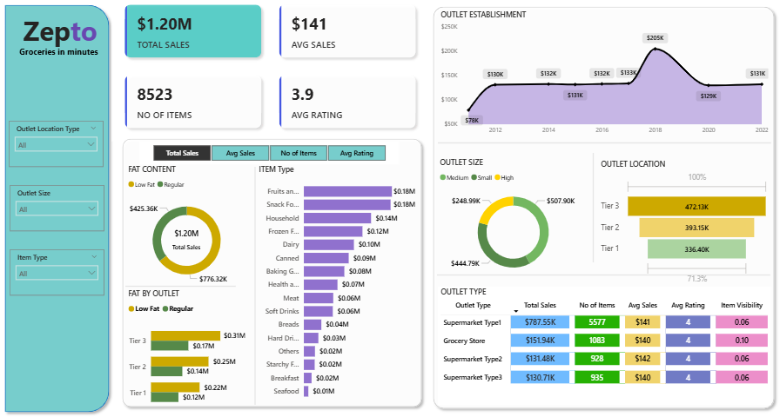
MAIN DASHBOARD

Slide 9
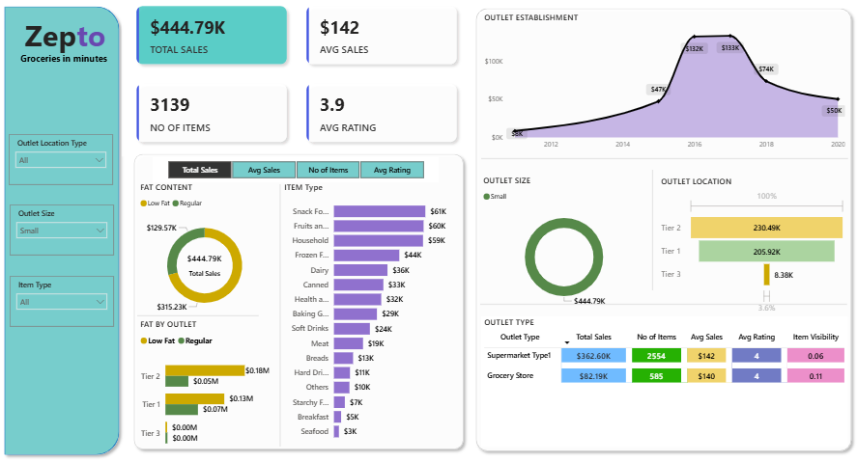
DASHBOARD : small outlet Size

Slide 10
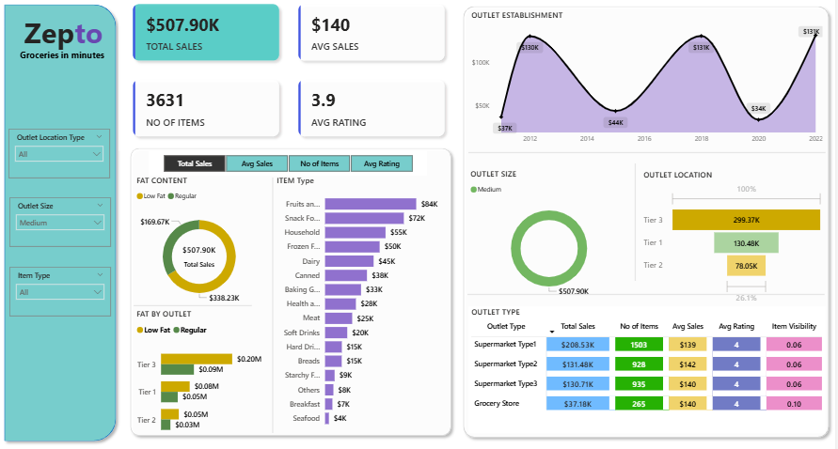
DASHBOARD : Medium outlet Size

Slide 11
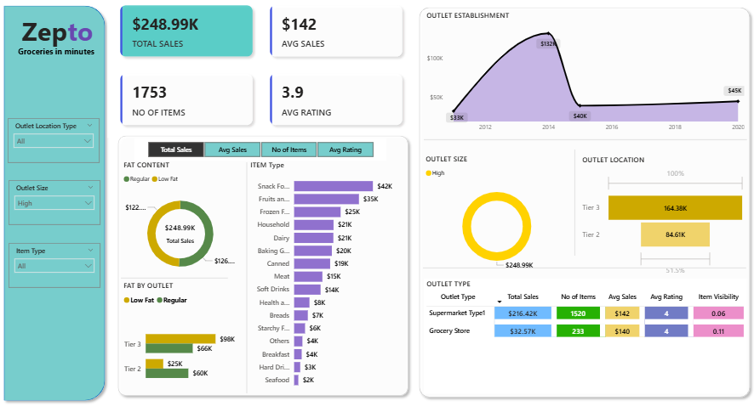
DASHBOARD : HIGH outlet Size

Slide 12
Conclusion:
Key findings: Model achieved strong holdout accuracy (MAPE 14.6%, MAE 8.1 units, RMSE 12.4)
and produced reliable quantile bands for safety‑stock calculations.
Operational effectiveness: Forecast‑driven reorder points project stockout reduction 7.8% → 4.2%,
enabling clearer daily actions via Power BI dashboards (Predicted vs Actual, error heatmap, reorder alerts).
Main challenges: Underperformance during short promotional spikes and for low‑volume SKUs due to sparse labels; manual file‑based refresh and retraining add operational friction.
Recommended improvements: Enrich features (detailed promotion and visibility flags, lead times), adopt
hierarchical/pooled models for sparse SKUs, and automate drift detection, retraining, and file refresh into Power BI.
Business impact and analogy: Accurate short‑term forecasts keep shelves stocked, reduce emergency
replenishment costs, and improve customer satisfaction—just as precise bike‑count predictions stabilize
urban rental fleets and ensure availability for riders.

Slide 13
Future scope:
Expand data sources: integrate promotion calendars, POS visibility, supplier lead times, footfall/mobility, and hyperlocal weather.
Model improvements: hybrid models (hierarchical + sequence), quantile regression, and automated hyperparameter tuning.
Handle sparse SKUs: pooled/hierarchical modeling and transfer learning for low‑volume items.
Automation & monitoring: drift detection, scheduled retraining, CI pipelines, and model performance alerts in Power BI.
Scalability & regions: hierarchical multi‑city models with local adaptation and centralized orchestration.
Edge/near‑edge inference: lightweight store/regional models for low latency and offline resilience.
Operational integration: feed quantile forecasts into automated reorder workflows and supplier SLAs.
Pilot & rollout: run 4–8 week A/B pilots, measure fill‑rate and cost impact, then scale successful policies.

Slide 14
References:
Internal dataset & dashboard: Zepto sales dataset (used for KPI and visualization inputs).
Tools & algorithms: Power BI, Prophet, LSTM, SARIMA, XGBoost, Scikit-learn, TensorFlow.
Implementation repo: GitHub — include link to project code, notebooks, and deployment scripts.
GitHub Link: https://github.com/HimanshuKumar-007/MS-Elevate-Power-BI-Internship

Slide 15
Thank You

